Slide 1
Natural Language Processing
From Foundations to Large Language Models

Slide 2






Course Agenda
Foundations
Deep Learning
Modern LLMs
Understanding NLP basics, text preprocessing, and traditional statistical methods.
Exploring Word Embeddings, RNNs, LSTMs, and the Attention Mechanism.
Transformers, BERT, GPT, Prompt Engineering, and RAG applications.

Slide 3

What is Natural Language Processing?
Natural Language Processing (NLP) is a subfield of linguistics, computer science, and artificial intelligence concerned with the interactions between computers and human language.
Goal: Enable computers to understand, interpret, and generate human languages seamlessly.
Challenge: Language is highly ambiguous, contextual, and complex.
Convergence: Blends computational linguistics with statistical, machine learning, and deep learning models.

Slide 4


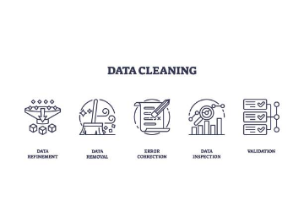
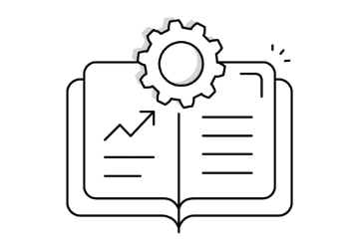

The Typical NLP Pipeline
1. Preprocessing
2. Modeling
3. Application
Cleaning, tokenizing, and standardizing raw text data for machine consumption.
Applying statistical or neural network models to extract patterns and meaning.
Deploying the model for tasks like translation, summarization, or sentiment analysis.

Slide 5
A Brief History of NLP
1990s - 2000s
2017 - Present
Statistical NLP: Shift to machine learning, utilizing probabilities from large text corpora (e.g., Hidden Markov Models).
Transformer & LLMs: The Attention Mechanism leads to massive foundation models like BERT, GPT, and Llama.
1950s - 1980s
2010s
Rule-Based Systems: Focus on complex, hand-written grammatical rules (e.g., ELIZA, SHRDLU).
Deep Learning Era: Neural networks, Word2Vec, RNNs, and LSTMs revolutionize performance across NLP tasks.

Slide 6


Text Preprocessing: The Basics
Tokenization
Normalization & Lemmatization
The process of breaking down a continuous stream of text into smaller units called tokens (words, subwords, or characters).
Standardizing text to reduce the vocabulary size and group variations of words.
Lowercasing: "Apple" → "apple"
"NLP is fun" → ["NLP", "is", "fun"]
Stemming: Chopping suffixes ("running" → "run")
Modern models use subword tokenization (Byte-Pair Encoding) to handle rare words and morphologically rich languages.
Lemmatization: Using dictionary forms ("better" → "good")

Slide 7
Traditional Text Representation
Feature | Bag of Words (BoW) | TF-IDF (Term Frequency - Inverse Document Frequency)
Concept | Counts the frequency of words in a document. | Evaluates how relevant a word is to a document within a collection.
Mechanism | Creates a sparse matrix of raw token counts. | Multiplies Term Frequency (TF) by Inverse Document Frequency (IDF).
Pros | Extremely simple to implement and understand. | Penalizes highly frequent, non-informative words (like "the", "and").
Cons | Treats all words equally; loses semantic meaning and word order. | Still ignores word order and semantic relationships between words.

Slide 8
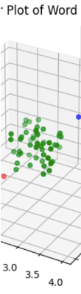
Word Embeddings: Mapping Meaning to Vectors
Word embeddings are dense vector representations where words with similar meanings have similar representations in a vector space.
Word2Vec (2013): Uses a shallow neural network to predict words based on context (CBOW) or context based on words (Skip-gram).
GloVe (2014): Matrix factorization technique based on global word co-occurrence statistics.
Capturing Semantics: Enables algebraic operations on words. Example:

Slide 9
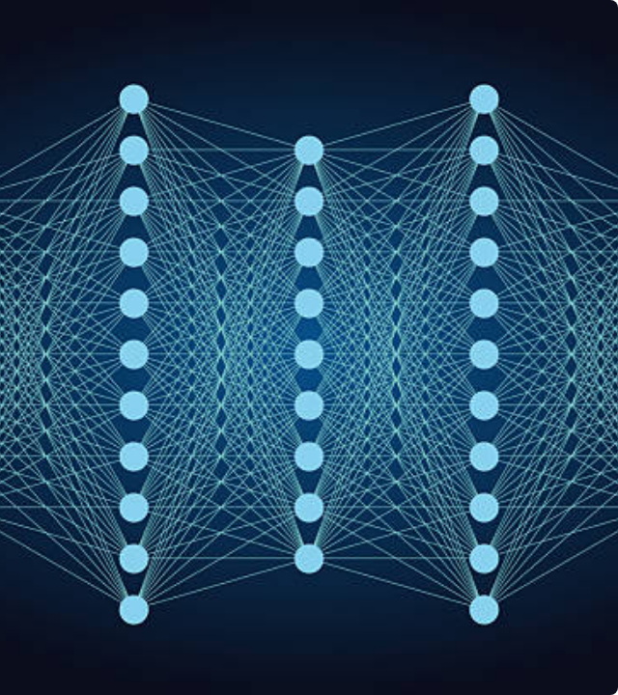
Deep Learning Enters NLP
The introduction of Deep Neural Networks allowed models to automatically learn hierarchical feature representations from raw text, bypassing manual feature engineering.
Recurrent Neural Networks (RNNs) became the standard for NLP because their architecture is inherently designed to process sequential data, maintaining a 'hidden state' that acts as memory for previous inputs.

Slide 10


Addressing Sequential Memory
The Problem with Vanilla RNNs
The LSTM Solution
While RNNs are built for sequences, they suffer from the Vanishing Gradient Problem.
Long Short-Term Memory (LSTM) networks were introduced to solve this exact issue.
During backpropagation, gradients shrink exponentially across long sequences.
Introduces a complex "cell state" that runs straight down the entire chain.
As a result, RNNs "forget" information from earlier in the text.
Uses Gates (Forget, Input, Output) to carefully regulate the flow of information.
They struggle with long-term dependencies (e.g., connecting a subject at the start of a paragraph to a verb at the end).
Can maintain context over much longer sequences, becoming the backbone of translation engines pre-2017.

Slide 11


The Attention Mechanism
Learning Where to Focus
Even LSTMs struggle with very long documents due to the bottleneck of compressing everything into a single fixed-length vector.
The Attention Mechanism allows the model to dynamically look at (attend to) different parts of the input sequence at every step of generation. Instead of a single vector, it creates a context-specific weighted sum of all input states.
"Pay attention to the word 'bank' when you see the word 'river'."

Slide 12
"
We propose a new simple network architecture, the Transformer, based solely on attention mechanisms, dispensing with recurrence and convolutions entirely.
— Vaswani et al., "Attention Is All You Need" (Google Research, 2017)

Slide 13
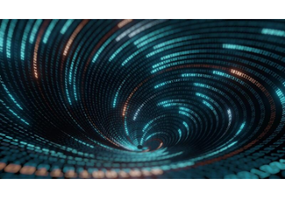
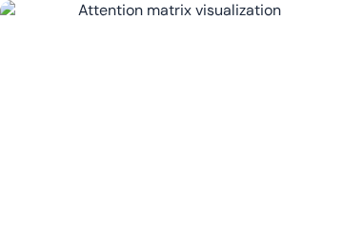
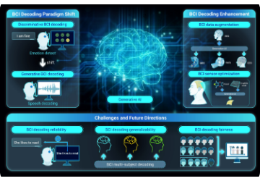
The Transformer Architecture
The Encoder
Self-Attention
The Decoder
Processes the entire input sequence simultaneously, generating rich, context-aware embeddings.
Every word looks at every other word in the sequence to compute its contextual relevance.
Generates the output sequence one token at a time, attending to both its own past outputs and the Encoder's representations.

Slide 14
Encoder-Only vs. Decoder-Only Models
Encoder-Only (e.g., BERT)
Decoder-Only (e.g., GPT series)
Designed for understanding and extracting information from text.
Designed for generative tasks and predicting the next word.
Bidirectional context: Looks at words before and after simultaneously.
Unidirectional context: Can only look at words that came before it (autoregressive).
Best for: Classification, sentiment analysis, named entity recognition, extractive Q&A.
Best for: Text generation, summarization, conversational AI, creative writing.
Cannot easily generate new text from scratch.
The foundation of modern chat models.

Slide 15
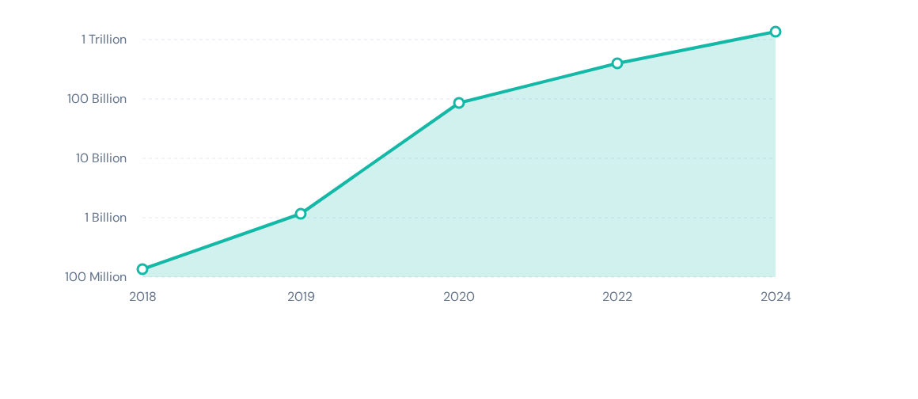
The Exponential Scaling of LLMs
Growth in model parameter count over time (Logarithmic Scale Approximation). From ELMo (94M) to GPT-3 (175B) and beyond.

Slide 16

BERT: Bidirectional Encoder Representations
Introduced by Google in 2018, BERT fundamentally changed how NLP models were pre-trained.
Masked Language Modeling (MLM): Randomly masks 15% of the words in a sentence and forces the model to predict them using both left and right context.
Next Sentence Prediction (NSP): Learns relationships between sentences by predicting if sentence B logically follows sentence A.
Impact: Achieved state-of-the-art results on 11 NLP tasks instantly, proving the power of bidirectional pre-training.

Slide 17

The GPT Series
Developed by OpenAI, the Generative Pre-trained Transformer models rely solely on the Decoder block.
Objective: Causal Language Modeling. The model is trained simply to predict the very next token in a sequence, given all previous tokens.
By scaling this simple objective across massive datasets and compute clusters, emergent abilities appeared: few-shot learning, reasoning, and instruction following.

Slide 18
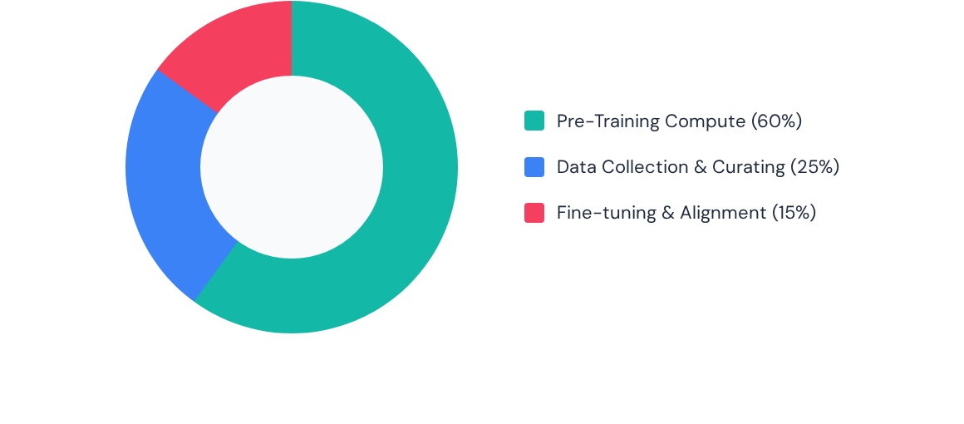
Resource Distribution in Modern LLMs
While Pre-Training consumes the vast majority of raw compute power, data curation and alignment (RLHF) dictate the model's actual utility and safety.

Slide 19






The LLM Training Pipeline
1. Data Collection
2. Base Pre-Training
3. Alignment / SFT
Scraping the internet, books, code repositories, and articles. Trillions of tokens are gathered, filtered for quality, and deduplicated.
Supervised Fine-Tuning turns the text-completer into a helpful assistant by training it on high-quality human Q&A examples.
The model learns grammar, facts, and reasoning by predicting the next word over months on thousands of GPUs. (Creates a "Base Model").

Slide 20
Reinforcement Learning from Human Feedback (RLHF)
RLHF is the secret sauce that makes models like ChatGPT safe, polite, and useful. It aligns the model with human preferences.
Step 1: Supervised Fine-Tuning (SFT). Train the base model on a curated dataset of prompts and ideal responses written by human experts.
Step 2: Reward Model Training. Generate multiple responses for a single prompt. Have humans rank these responses from best to worst. Train a separate "Reward Model" to predict these human rankings.
Step 3: PPO Optimization. Use Proximal Policy Optimization (a reinforcement learning algorithm). The main LLM generates a response, the Reward Model scores it, and the LLM updates its weights to maximize the score.
Result: A model that actively avoids toxic output, refuses harmful prompts, and formats answers optimally.

Slide 21


Prompt Engineering Strategies
Zero-Shot & Few-Shot Prompting
Chain-of-Thought (CoT)
Directing the model's behavior through the prompt structure without changing its weights.
Eliciting reasoning capabilities from the model by forcing it to break down problems.
Zero-shot: Asking a question directly. "Classify this text as positive or negative: [Text]"
Adding the phrase "Let's think step by step" to the prompt.
Few-shot: Providing examples in the prompt to establish a pattern. "English: Hello -> French: Bonjour. English: Apple -> French: ?"
Significantly improves performance on logic, math, and complex reasoning tasks by utilizing generation time as "computation time".

Slide 22
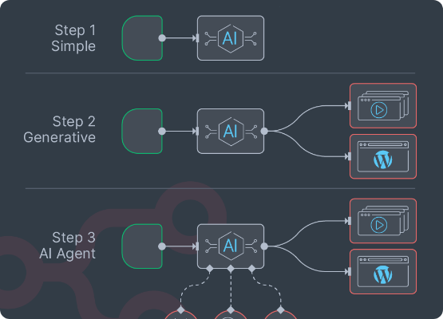
Retrieval-Augmented Generation (RAG)
LLMs have a knowledge cutoff and hallucinate facts. RAG solves this by grounding generation in external data.
Embed & Store: Convert enterprise documents into vector embeddings and store them in a Vector Database.
Retrieve: When a user asks a query, convert the query to a vector and fetch the top K most similar document chunks.
Generate: Feed the retrieved chunks + the user query to the LLM. "Based on the provided context, answer the user."
Benefit: Factual, verifiable answers without retraining the model.

Slide 23
Evaluation Metrics
Metric | Primary Use Case | How it Works
Accuracy / F1 | Classification, Sentiment Analysis | Measures exact matches of predicted classes vs. actual ground truth.
BLEU | Machine Translation | Measures precision of n-gram overlaps between generated text and human reference.
ROUGE | Text Summarization | Measures recall of n-gram overlaps (how much of the reference summary is captured).
Perplexity | Language Modeling | Measures how well a probability model predicts a sample (lower is better).
LLM-as-a-Judge | Open-ended Generation | Using a superior LLM (e.g., GPT-4) to score responses based on human-aligned rubrics.

Slide 24
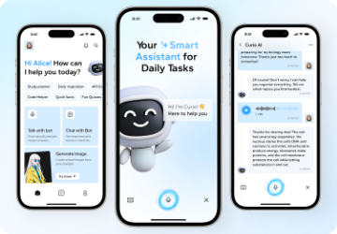
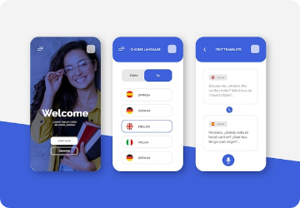

Real-World NLP Applications
Customer Support
Real-time Translation
Clinical Informatics
Automated chatbots and triage systems routing support tickets via intent classification.
Breaking language barriers with near-instant context-aware translation tools.
Extracting structured patient data from unstructured EHR notes for research.

Slide 25

Ethical Considerations & Bias
With Great Power...
NLP models learn from human data, meaning they inherit human biases, stereotypes, and prejudices.
Representational Harm: Associating specific genders or races with negative sentiment or specific jobs.
Hallucinations: Generating authoritative but entirely false information.
Data Privacy: Models inadvertently memorizing and regurgitating PII from training sets.
Environmental Impact: The massive carbon footprint of training trillion-parameter models.

Slide 26
Lab 1: Sentiment Analysis with Transformers
Using the Hugging Face Pipeline API to classify text sentiment in Python.

Slide 27
Lab 2: Building a Simple RAG Application
Connecting LLMs to external data using LangChain and Vector Databases.

Slide 28






The Future of NLP
Multimodal AI
Efficient AI (SLMs)
Agentic NLP
Moving beyond just text. Models that natively understand and generate text, audio, images, and video simultaneously (e.g., GPT-4o, Gemini).
Small Language Models running locally on edge devices and phones, providing privacy and zero latency without the massive cloud compute.
AI systems that don't just chat, but can plan, use tools, browse the web, and execute autonomous tasks across software ecosystems.

Slide 29
Key Takeaways
Evolution: NLP has evolved from rigid rule-based systems to highly adaptable probabilistic and neural models.
The Transformer Shift: The attention mechanism fundamentally solved the sequence bottleneck, allowing models to scale exponentially.
Pre-training is Universal: Almost all modern NLP relies on transfer learning—taking a massive foundation model and adapting it.
RAG is the Enterprise Standard: Retrieval-Augmented Generation bridges the gap between LLM intelligence and proprietary, factual data.
Ethics Matter: As these systems become pervasive, active mitigation of bias, toxicity, and hallucinations is paramount.

Slide 30
Questions?

